Slide 1
DAHEL TECHNOLOGY
DATA ANALYTICS INTERNSHIP PROJECT
JANUARY COHORT GROUP 2

Slide 2
PROJECT TEAM MEMBERS
Love Eka
Norah Kanu Enun
Aroh Sylvester Chijioke
Ejike Ugochinyere Grace
Akpan, Ekeminiabasi Uduak
Amaka Odigwe

Slide 3
DAHEL DATA ANALYTICS CAPSTONE PROJECT(JANUARY COHORT)
PROJECT TOPIC: ANALYSIS ON GLOBAL SUPERSTORE SALES
INDUSTRY : GLOBAL COMMERCE AND LOGISTICS
PREPARED BY: GROUP 2
Tools Used:
Kaggle
Microsoft Excel
Tableau
Data Cleaning
Data Modeling
Analysis

Slide 4
GLOBAL SUPERSTORES
Executive Business Performance Review on Global
Superstores Sales
Reporting Period: 2011- 2014

Slide 5
BUSINESS PROBLEM
Global Superstore generates strong sales across different products, customers, and regions, but management needs a clearer understanding of what drives revenue and profitability. The company aims to identify its most valuable customers and best-performing products, understand sales trends throughout the year, improve delivery performance, and uncover opportunities to increase sales, reduce losses, and support sustainable business growth.

Slide 6
PROJECT OBJECTIVES
This project aims to analyze Global Superstore's sales, customer, product, and shipping data to uncover key business insights. The analysis focuses on identifying the most valuable customer segments, evaluating product performance and profitability, understanding sales trends and seasonal patterns, assessing shipping efficiency, and providing actionable recommendations that support better decision-making, improve operational performance, and drive business growth.

Slide 7
PROJECT APPROACH
Excel was used to clean, organize, and prepare the Global Superstore dataset for analysis.
The cleaned data was imported into Tableau for visualization and dashboard creation.
Tableau dashboards were built to analyze sales, customers, products, and shipping performance.
Key metrics and trends were explored across regions, segments, and product categories.
Visual insights were developed to support clear, data-driven business decision-making.

Slide 8
ANALYSIS TOOL
All analysis and insights were developed using Tableau through interactive dashboards that visualize sales performance, customer behavior, product trends, and shipping efficiency. .

Slide 9
DASHBOARDS
Dashboards were built in Tableau to provide clear, interactive insights into the performance of the Global Superstore business. Data from the Global Superstore dataset was connected and modeled, key metrics were visualized using charts, maps, and KPI banners, and interactive filters were added for Market, Year, and Sub-Category. The result is an easy-to-use set of dashboards that lets executives, finance managers, and operations teams quickly explore business performance and make data-driven informed decisions.
Global Sales Command Centre
↓
Profitability Deep-Dive
↓
Operations & Trends

Slide 10
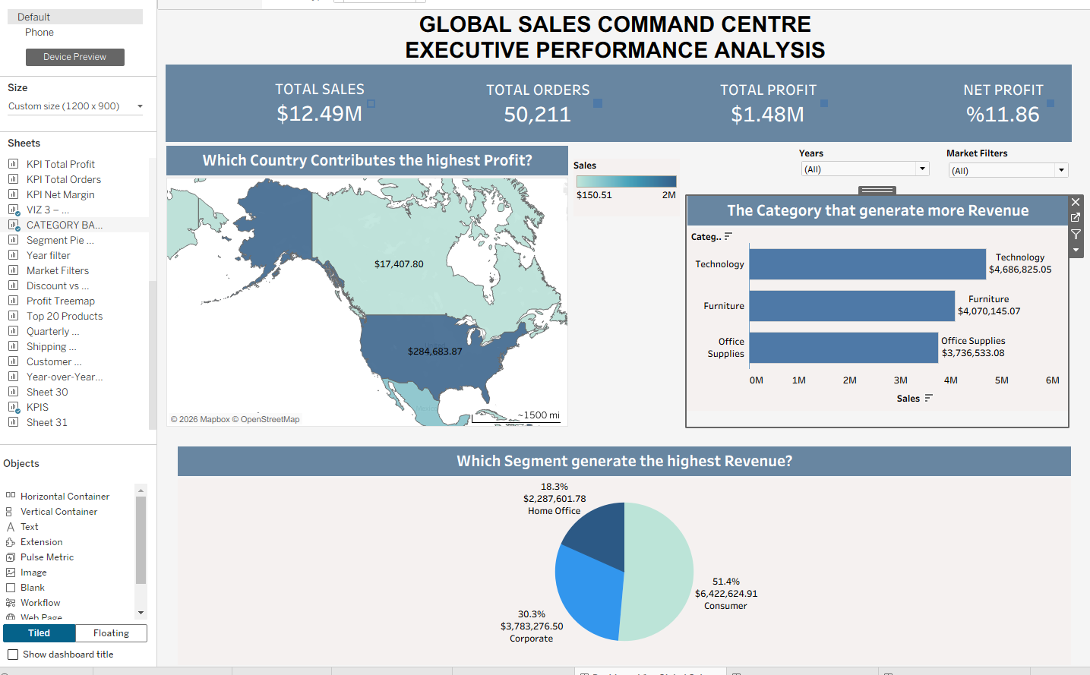
GLOBAL COMMAND CENTRE
KEY INSIGHT:
The Global Sales Command Centre reveals that the business generates $12.49M in total sales across all markets, with Technology emerging as the top revenue-generating category at $4.69M. The Consumer segment dominates with 51.4% of total revenue, confirming that individual buyers are the most valuable customer group. However, despite strong sales performance, the net profit margin stands at only 11.86%, indicating that cost drivers such as discounting and logistics need to be addressed to convert revenue growth into sustainable profitability.

Slide 11
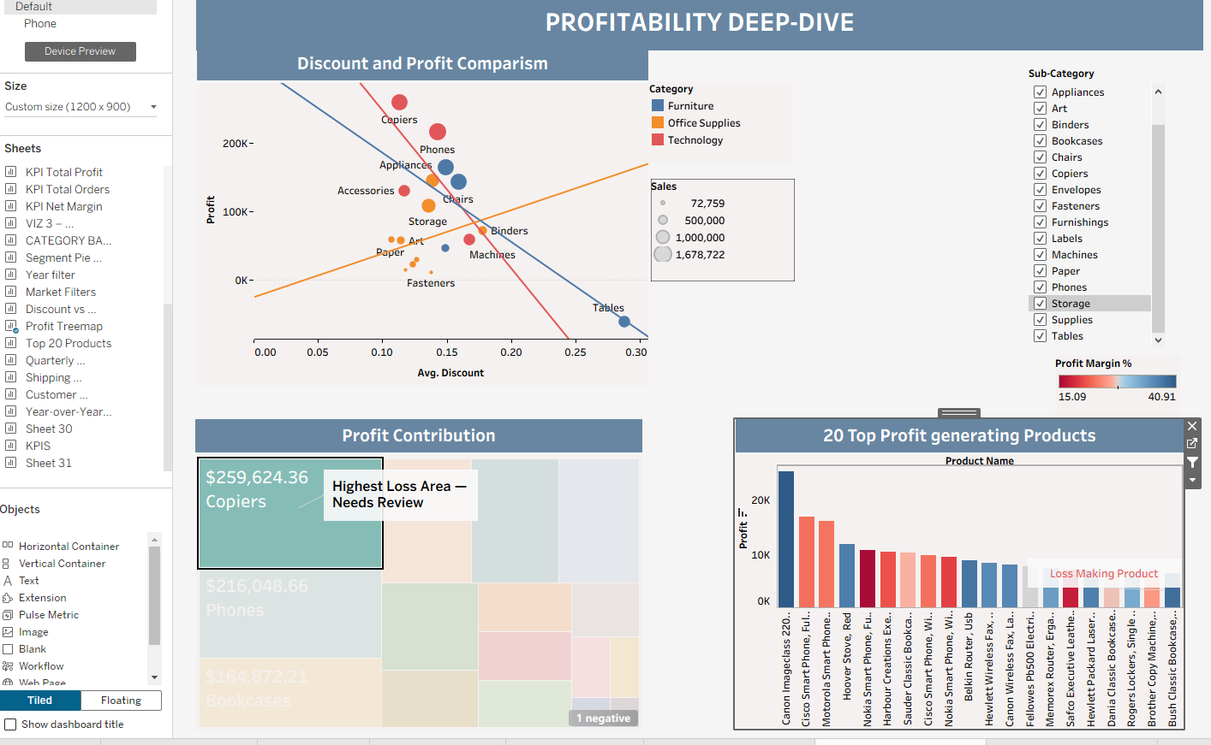
PROFITABILITY DEEP-DIVE
KEY INSIGHT:
The Profitability Deep-Dive exposes a clear relationship between excessive discounting and profit loss, with tables being the single most loss-making sub-category due to an average discount of ~29%. In contrast, Copiers ($259K) and Phones ($216K) stand out as the strongest profit contributors, demonstrating that disciplined pricing in the Technology category drives the best margins. Several products in the Top 20 chart are also generating negative profit, requiring immediate review and intervention to prevent further erosion of the company's bottom line.

Slide 12
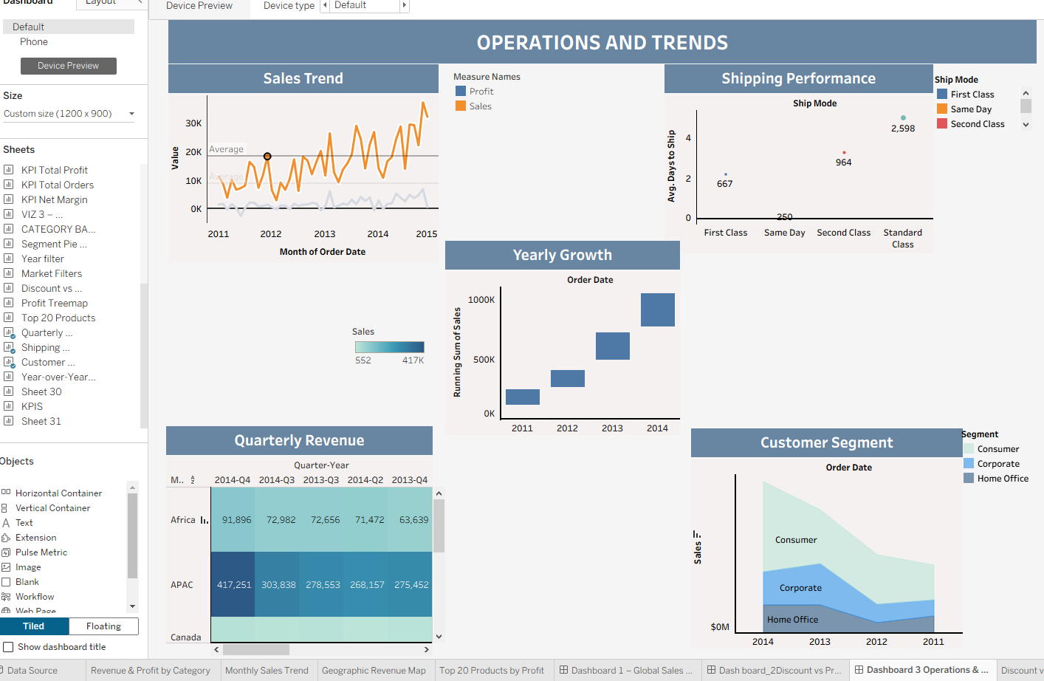
OPERATIONS AND TREND
The Operations and Trends dashboard shows consistent year-on-year revenue growth from 2011 to 2014, yet profit growth has not kept pace, suggesting that rising operational costs are offsetting sales gains. Standard Class shipping, which handles the largest order volume at 2,598 orders, averages 5–7 days to deliver — posing a risk to customer satisfaction if not improved. Regionally, APAC consistently outperforms all other markets, reaching $417K in Q4 2014 alone, making it the most strategic region for future inventory planning and marketing investment.

Slide 13
KEY FINDINGS
Global Superstore is doing well in terms of sales, bringing in over $12 million largely from technology products and everyday consumers, but the business is not keeping as much money as it should because too many products are being sold at heavy discounts, delivery is slower than it needs to be, and the company is leaning too heavily on one type of customer all of which are quietly eating into profits and need to be fixed to keep the business growing healthily.

Slide 14
BUSINESS ANALYSIS
The Global Superstore analysis reveals a business with strong revenue generation capabilities, achieving total sales of $12.49 million across multiple markets and customer segments. The Consumer segment contributes more than half of total revenue (51.4%), highlighting the importance of individual customers to the company's overall success. Technology is the strongest-performing category, generating $4.69 million in sales and reinforcing its position as the primary driver of business growth.
Despite impressive sales performance, profitability remains a key challenge. The company maintains a profit margin of 11.86%, suggesting that a significant portion of revenue is being absorbed by discounts, shipping expenses, and operational costs. Further analysis shows that excessive discounting is one of the major contributors to reduced profitability.
The profitability dashboard highlights a substantial difference in performance across product categories. While products such as Copiers and Phones generate the highest profit contributions, the Tables sub-category consistently records losses due to heavy discounting, averaging approximately 29%. This indicates that strong sales alone do not guarantee profitability. Several products within the top-selling product group are also generating negative profit, demonstrating the need for closer monitoring of pricing strategies and product-level performance.
These findings suggest that future growth should focus not only on increasing sales but also on improving profit margins through better discount management, optimized pricing strategies, and stronger focus on high-margin products.
The business has experienced steady growth over the years, showing that customer demand remains strong. However, profits have not increased at the same rate as sales, suggesting that rising operating and delivery costs may be reducing overall business performance.
Delivery performance remains an important part of the customer experience. Most orders are shipped using Standard Class delivery, which takes between five and seven days on average. As order volumes continue to grow, improving delivery efficiency could help increase customer satisfaction and encourage repeat purchases.
The Asia-Pacific (APAC) region stands out as the company's strongest market, consistently generating the highest sales among all regions. This presents a valuable opportunity for the business to invest more heavily in inventory, marketing, and customer acquisition efforts within the region.
Overall, the company is in a strong position for future growth. By improving profitability, reducing losses on underperforming products, enhancing delivery performance, and investing in high-performing markets, the business can strengthen its financial performance and continue expanding successfully.

